Slide 1
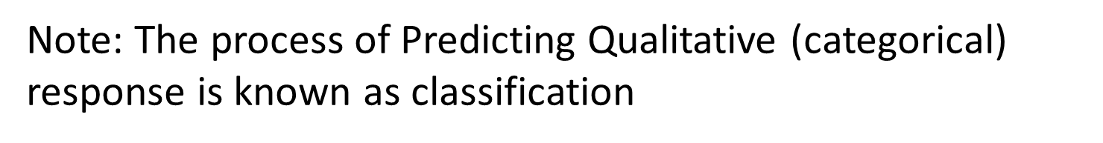
Classification Methods
Chapter 04
Classifiers like:1) logistic Regression 2) Linear discriminant analysis 3) KNN

Slide 2
Logistic Regression

Slide 3
Outline
Cases:
Orange Juice Brand Preference
Credit Card Default Data
Why Not Linear Regression?
Simple Logistic Regression
Logistic Function
Interpreting the coefficients
Making Predictions
Adding Qualitative Predictors
Multiple Logistic Regression

Slide 4
Case 1: Brand Preference for Orange Juice
We would like to predict what customers prefer to buy: Citrus Hill (CH) or Minute Maid (MM) orange juice?
The Y (Purchase) variable is categorical: 0 or 1
The X (LoyalCH) variable is a numerical value (between 0 and 1) which specifies the how much the customers are loyal to the Citrus Hill (CH) orange juice
Can we use Linear Regression when Y is categorical?

Slide 5
Why not Linear Regression?
When Y only takes on values of 0 and 1, why standard linear regression is inappropriate?
0.9
0.7
How do we interpret values greater than 1?
Purchase
0.5
0.4
0.2
How do we interpret values of Y between 0 and 1?
0.0
.0
.1
.2
.3
.4
.5
.6
.7
.8
.9
1.0
LoyalCH

Slide 6
Problems
The regression line β₀+β₁X can take on any value between negative and positive infinity
In the orange juice classification problem, Y can only take on two possible values: 0 or 1.
Therefore the regression line almost always predicts the wrong value for Y in classification problems

Slide 7
Solution: Use Logistic Function
Instead of trying to predict Y, let’s try to predict P(Y = 1), i.e., the probability a customer buys Citrus Hill (CH) juice.
Thus, we can model P(Y = 1) using a function that gives outputs between 0 and 1.
We can use the logistic function
Logistic Regression!

Slide 8
Logistic Regression
1
Logistic regression is very similar to linear regression
We come up with b₀ and b₁ to estimate β₀ and β₁.
We have similar problems and questions as in linear regression
e.g. Is β₁ equal to 0? How sure are we about our guesses for β₀ and β₁?
MM
0.75
0.5
P(Purchase)
CH
0.25
0
.0
.2
.4
.6
.7
.9
LoyalCH
If LoyalCH is about .6 then Pr(CH) ≈ .7.

Slide 9
Case 2: Credit Card Default Data
We would like to be able to predict customers that are likely to default
Possible X variables are:
Annual Income
Monthly credit card balance
The Y variable (Default) is categorical: Yes or No
How do we check the relationship between Y and X?

Slide 10
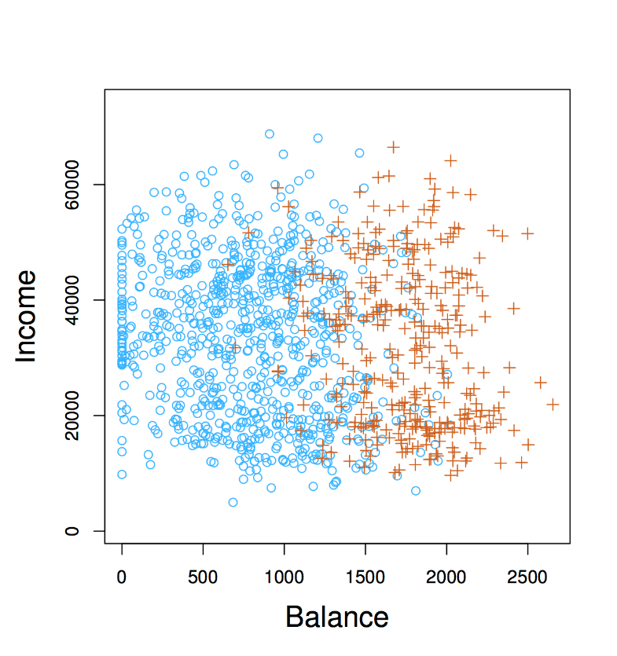
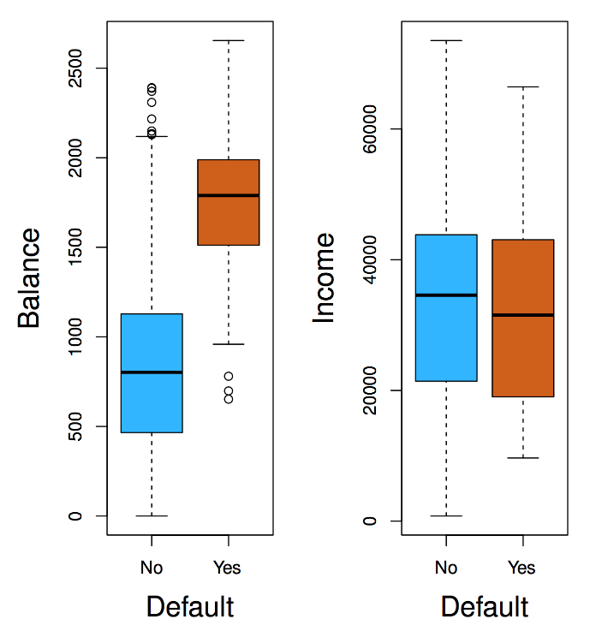
The Default Dataset
Orange: defaulters on credit card payment
Individuals who defaulted tended to have higher credit card balances than those who did not

Slide 11
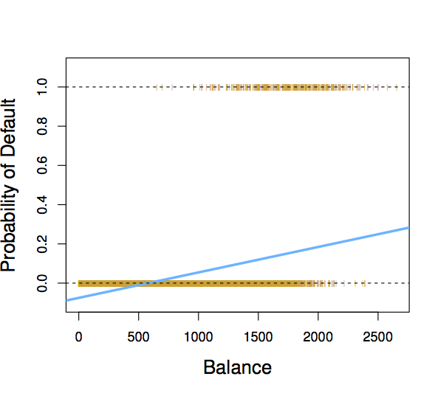

Why not Linear Regression?
If we fit a linear regression to the Default data, then for very low balances we predict a negative probability, and for high balances we predict a probability above 1!
When Balance < 500,
Pr(default) is negative!
To avoid this problem, we use logistic function
$$p\left(x\right)=\frac{e^{β_{0}+β_{1}X}}{1+ e^{β_{0}+β_{1}X}}$$

Slide 12
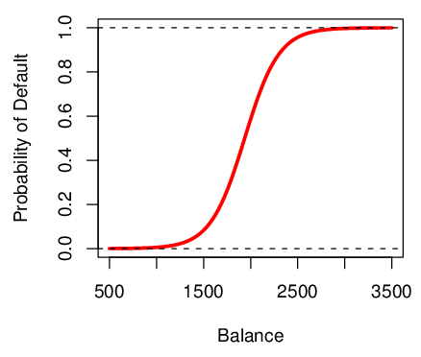
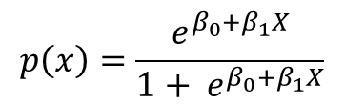
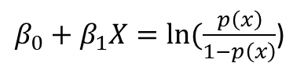
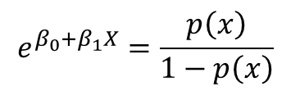
Logistic Function on Default Data
Now the probability of default is close to, but not less than zero for low balances. And close to but not above 1 for high balances
$$p\left(x\right)=\frac{e^{β_{0}+β_{1}X}}{1+ e^{β_{0}+β_{1}X}}$$
$$e^{β_{0}+β_{1}X}=\frac{p\left(x\right)}{1−p\left(x\right)}$$
$β_{0}+β_{1}X=ln⁡(\frac{p\left(x\right)}{1−p\left(x\right)}$)
odds
logit

Slide 13
Interpreting β₁
Interpreting what β₁ means is not very easy with logistic regression, simply because we are predicting P(Y) and not Y.
If β₁ =0, this means that there is no relationship between Y and X.
If β₁ >0, this means that when X gets larger so does the probability that Y = 1.
If β₁ <0, this means that when X gets larger, the probability that Y = 1 gets smaller.
But how much bigger or smaller depends on where we are on the slope

Slide 14
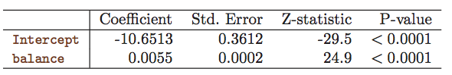
Are the coefficients significant?
We still want to perform a hypothesis test to see whether we can be sure that are β₀ and β₁ significantly different from zero.
We use a Z test instead of a T test, but of course that doesn’t change the way we interpret the p-value
Here the p-value for balance is very small, and b₁ is positive, so we are sure that if the balance increase, then the probability of default will increase as well.
β₀
β₁

Slide 15
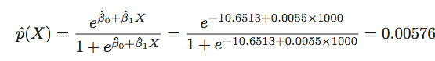
Making Prediction
Suppose an individual has an average balance of $1000. What is their probability of default?
The predicted probability of default for an individual with a balance of $1000 is less than 1%.
For a balance of $2000, the probability is much higher, and equals to 0.586 (58.6%).

Slide 16
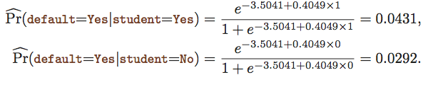
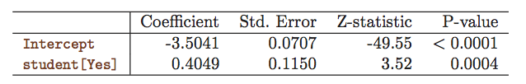
Qualitative Predictors in Logistic Regression
We can predict if an individual default by checking if she is a student or not. Thus we can use a qualitative variable “Student” coded as (Student = 1, Non-student =0).
b₁ is positive: This indicates students tend to have higher default probabilities than non-students

Slide 17
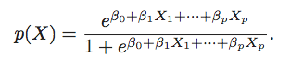
Multiple Logistic Regression
We can fit multiple logistic just like regular regression

Slide 18
Logistic Regression
Logistic response function
Interpretation of coefficients
If we increase x₁ by one unit, holding x₂, x₃ … x_{q} constant, then exp(beta₁) is the factor by which the odds of belonging to class 1 increase

Slide 19
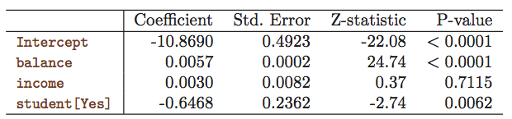
Multiple Logistic Regression- Default Data
Predict Default using:
Balance (quantitative)
Income (quantitative)
Student (qualitative)

Slide 20
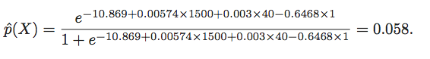
Predictions
A student with a credit card balance of $1,500 and an income of $40,000 has an estimated probability of default

Slide 21
An Apparent Contradiction!
Positive
Negative

Slide 22
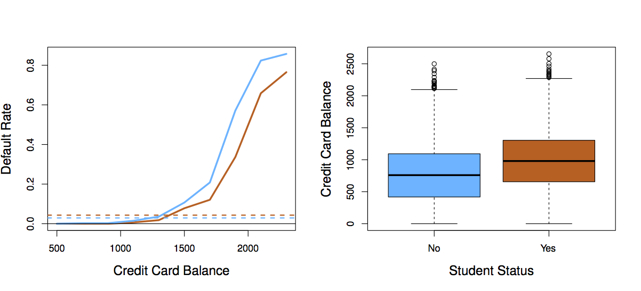
Students (Orange) vs. Non-students (Blue)
Orange: Students
Blue: non-Students
Solid lines: display default rate as a function of balance
Broken lines: overall default rates

Slide 23
To whom should credit be offered?
A student is risker than non students if no information about the credit card balance is available
However, that student is less risky than a non student with the same credit card balance!

Slide 25
Linear Discriminant Analysis (LDA) & Quadratic Discriminant Analysis (QDA)

Slide 26
Outline
Overview of LDA
Why not Logistic Regression?
Estimating Bayes’ Classifier
LDA Example with One Predictor (p=1)
LDA Example with more than One Predictor (P>1)
LDA on Default Data
Overview of QDA
Comparison between LDA and QDA

Slide 27
Linear Discriminant Analysis
LDA undertakes the same task as Logistic Regression. It classifies data based on categorical variables
Making profit or not
Buy a product or not
Satisfied customer or not
Political party voting intention

Slide 28
Why Linear? Why Discriminant?
LDA involves the determination of linear equation (just like linear regression) that will predict which group the case belongs to.
D: discriminant function
v: discriminant coefficient or weight for the variable
X: variable
a: constant

Slide 29

Purpose of LDA
Choose the v’s in a way to maximize the distance between the means of different categories
Good predictors tend to have large v’s (weight)
We want to discriminate between the different categories
Think of food recipe. Changing the proportions (weights) of the ingredients will change the characteristics of the finished cakes. Hopefully that will produce different types of cake!

Slide 30
Assumptions of LDA
The observations are a random sample
Each predictor variable is normally distributed

Slide 31
Why not Logistic Regression?
Logistic regression is unstable when the classes are well separated
In the case where n is small, and the distribution of predictors X is approximately normal, then LDA is more stable than Logistic Regression
LDA is more popular when we have more than two response classes

Slide 32
Bayes’ Classifier
Bayes’ classifier is the golden standard. Unfortunately, it is unattainable.
So far, we have estimated it with two methods:
KNN classifier
Logistic Regression

Slide 33
Estimating Bayes’ Classifier
With Logistic Regression we modeled the probability of Y being from the k^{th} class as
=
However, Bayes’ Theorem states
=
: Probability of coming from class k (prior probability)
: Density function for X given that X is an observation from class k

Slide 34
Estimate and
We can estimate and to compute
The most common model for is the Normal Density
Using the density, we only need to estimate three quantities to compute

Slide 35
Use Training Data set for Estimation
The mean could be estimated by the average of all training observations from the k^{th} class.
The variance could be estimated as the weighted average of variances of all k classes.
And, is estimated as the proportion of the training observations that belong to the k^{th} class.

Slide 36
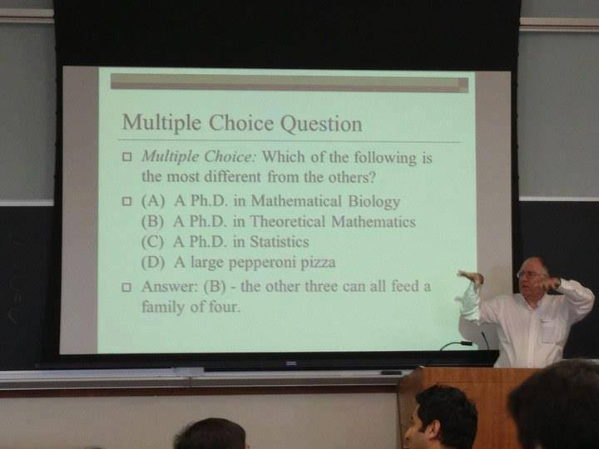

Slide 37
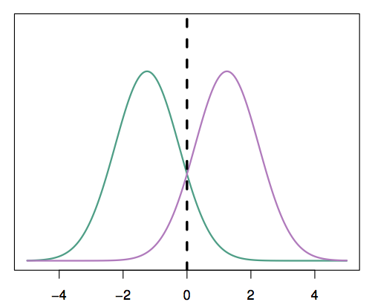
A Simple Example with One Predictor (p =1)
Suppose we have only one predictor (p = 1)
Two normal density function f₁(x) and f₂(x), represent two distinct classes
The two density functions overlap, so there is some uncertainty about the class to which an observation with an unknown class belongs
The dashed vertical line represents Bayes’ decision boundary

Slide 38
Apply LDA
LDA starts by assuming that each class has a normal distribution with a common variance
The mean and the variance are estimated
Finally, Bayes’ theorem is used to compute p_{k} and the observation is assigned to the class with the maximum probability among all k probabilities

Slide 39
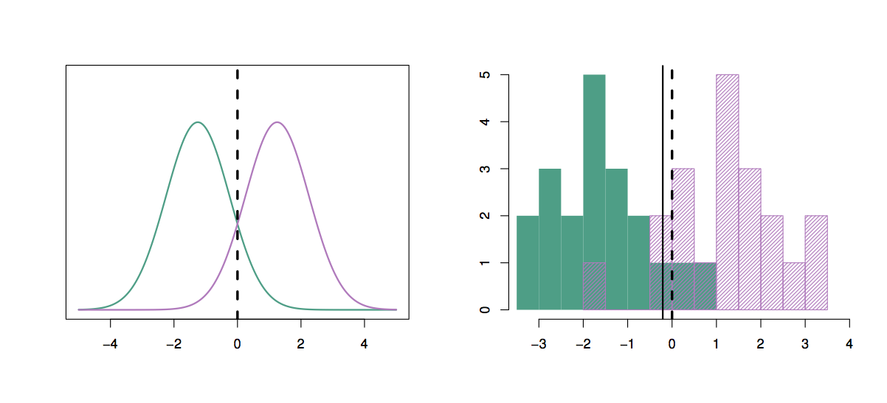
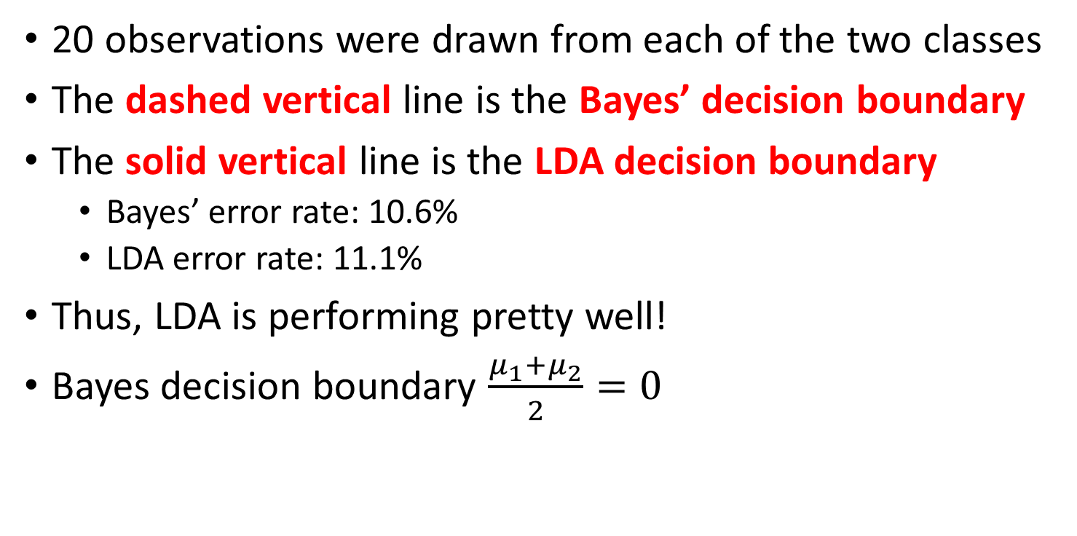
20 observations were drawn from each of the two classes
The dashed vertical line is the Bayes’ decision boundary
The solid vertical line is the LDA decision boundary
Bayes’ error rate: 10.6%
LDA error rate: 11.1%
Thus, LDA is performing pretty well!
Bayes decision boundary $\frac{μ_{1}+μ_{2}}{2}=0$
LDA
Bayes

Slide 40
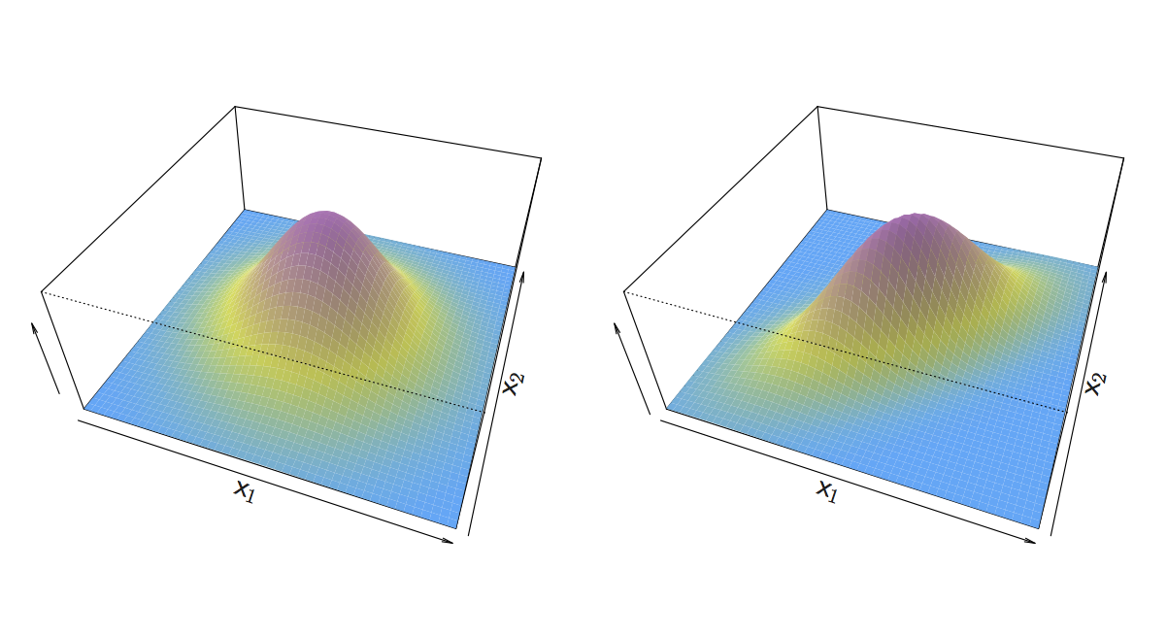
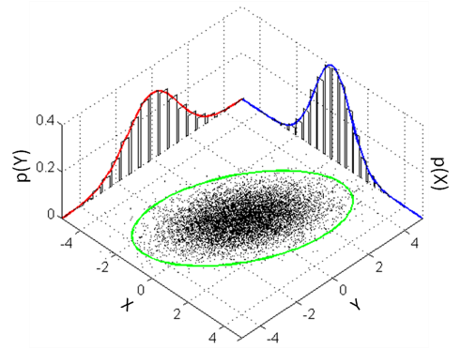
An Example When p > 1
If X is multidimensional (p > 1), we use exactly the same approach except the density function f(x) is modeled using the multivariate normal density
Equal variance
no correlation
Circular base
Non-Equal variance
some correlation
Elliptical base
Cross-section has the shape of a one-dimensional normal distribution

Slide 41
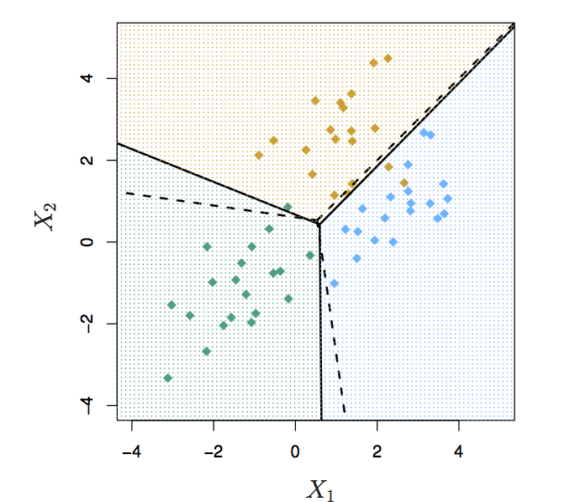
We have two predictors (p =2)
Three classes, common covariance matrix
20 observations were generated from each class
The solid lines are Bayes’ boundaries
The dashed lines are LDA boundaries
Ellipses: region with 95% prob. of each class

Slide 42
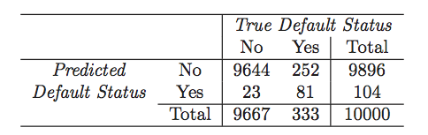
Running LDA on Default Data
LDA makes 252+ 23 mistakes on 10,000 predictions (2.75% misclassification error rate)
But LDA miss-predicts 252/333 = 75.5% of defaulters!
Identifying high-riskers? Error rate is high/unacceptable!
Perhaps, we shouldn’t use 0.5 as threshold for predicting default?
Confusion Matrix

Slide 43
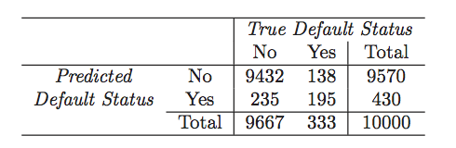
Use 0.2 as Threshold for Default
P(default=yes|X=x) > 0.2 assign to default class
Now the total number of mistakes is 235+138 = 373 (3.73% misclassification error rate)
But we only miss-predicted 138/333 = 41.4% of defaulters
We can examine the error rate with other thresholds

Slide 44
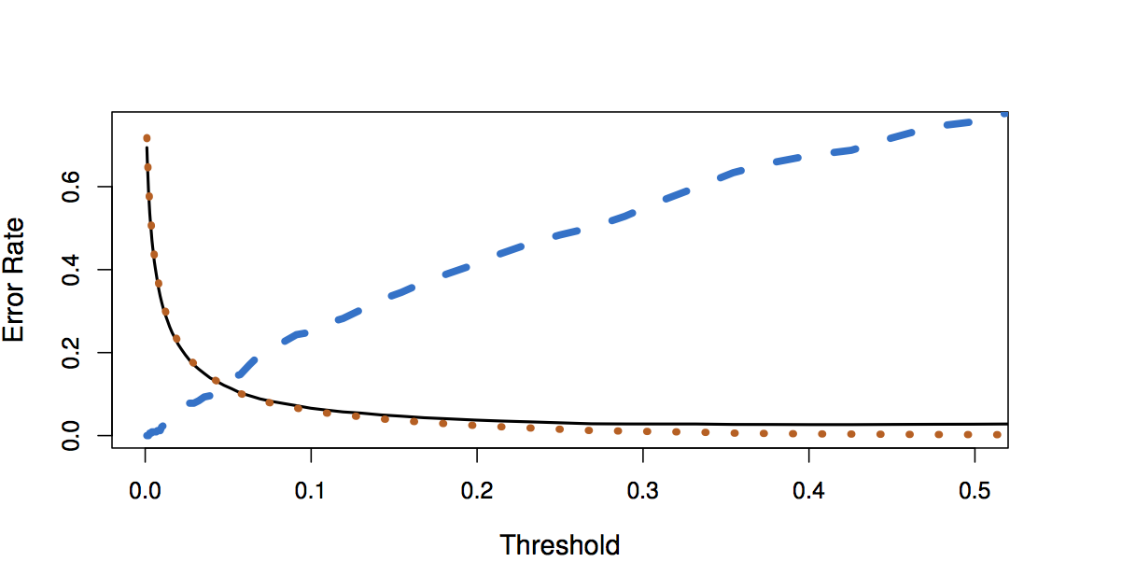
Default Threshold Values vs. Error Rates
Black solid: overall error rate
Blue dashed: Fraction of defaulters missed
Orange dotted: non defaulters incorrectly classified

Slide 45
How can we decide which threshold value is best?
Such a decision must be based on domain knowledge (e.g., cost associated with default)
Receiver operating characteristic (ROC)
Displays two types of errors for all possible thresholds.
Overall performance over all possible thresholds is given by the area under the ROC (AUC).
The larger the AUC, the better the classifier

Slide 46
ROC
* ROC curves are used for comparing different classifiers (since they take into account all possible thresholds)
* Ideal ROC indicates high true positive & low false positive rate
Sensitivity and Specificity
Sensitivity: True Positive rate (the fraction of defaulters correctly identified)
Specificity: 1- False Positive; (the fraction of non-defaulters classified incorrectly)

Slide 47
Performance measures

Slide 48
Quadratic Discriminant Analysis (QDA)
LDA assumes that observations within each class has multivariate normal distribution
LDA assumes that every class has the same variance/ covariance
However, LDA may perform poorly if this assumption is far from true
QDA works identically as LDA except that it estimates separate variances/ covariance for each class

Slide 49
Which is better? LDA or QDA?
Since QDA allows for different variances among classes, the resulting boundaries become quadratic
Which approach is better: LDA or QDA?
QDA will work best when the variances are very different between classes and we have enough observations to accurately estimate the variances
LDA will work best when the variances are similar among classes or we don’t have enough data to accurately estimate the variances

Slide 50
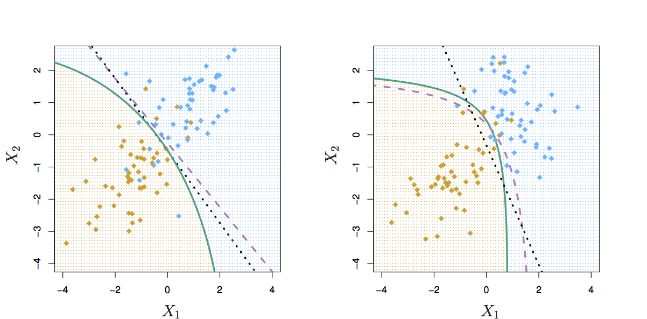
Comparing LDA to QDA
Black dotted: LDA boundary
Purple dashed: Bayes’ boundary
Green solid: QDA boundary
Left: variances of the classes are equal (LDA is better fit)
Right: variances of the classes are not equal (QDA is better fit)

Slide 51
Comparison of Classification Methods
KNN (Chapter 2)
Logistic Regression (Chapter 4)
LDA (Chapter 4)
QDA (Chapter 4)

Slide 52
Logistic Regression vs. LDA
Similarity: Both Logistic Regression and LDA produce linear boundaries
Difference: LDA assumes that the observations are drawn from the normal distribution with common variance in each class, while logistic regression does not have this assumption. LDA would do better than Logistic Regression if the assumption of normality hold, otherwise logistic regression can outperform LDA

Slide 53
KNN vs. (LDA and Logistic Regression)
KNN takes a completely different approach
KNN is completely non-parametric: No assumptions are made about the shape of the decision boundary!
Advantage of KNN: We can expect KNN to dominate both LDA and Logistic Regression when the decision boundary is highly non-linear
Disadvantage of KNN: KNN does not tell us which predictors are important (no table of coefficients)

Slide 54
QDA vs. (LDA, Logistic Regression, and KNN)
QDA is a compromise between non-parametric KNN method and the linear LDA and logistic regression. Performs better if limited # of observations
If the true decision boundary is:
Linear: LDA and Logistic outperforms
Moderately Non-linear: QDA outperforms
More complicated: KNN is superior

Slide 56
Logistic Regression Models with One Predictor
Modeling the Probability of Loan Acceptance
Interpretation of Parameters: Odds and Odds Ratios
Confusion Matrix and ROC Curve
Slides based on slides by Shmueli, Patel and Bruce (2010)

Slide 57
Universal Bank (1 Predictor)
Universal Bank is a relatively young bank that has already developed itself as a brand name in consumer banking. The bank is trying to expand its customer base, and has recently conducted a comprehensive study to understand what combinations of factors make a loan-seeker more likely to accept a personal loan that the bank offers. The bank’s dataset includes data on 5,000 loan-seekers that were offered the loan. A sample from the data is displayed below.
You are the head of the data analytics division at the Universal Bank. You have delegated your staff to find out the relationship (if any) between the income of the loan-seeker and the likelihood that he/she will in fact accept the loan.

Slide 58
Universal Bank (1 Predictor)
continued
The scatter plot of the probability of loan acceptance versus the income for each of the 5,000 loan seekers in Universal Bank’s database is depicted below
Fit a simple linear regression (manually ballpark) to these data.
Do you think it is a good fit? Why or why not?
Suppose a new loan-seeker walks into a bank with an income of 300,000. What would your linear regression model predict as the likelihood that he/she accepts the loan?

Slide 59
Logistic Regression
As we saw, in case the variable being modeled (the outcome) is a probability of a categorical variable, the linear regression models are inappropriate.
Logistic regression, on the other hand, offers an effective model to be fit to data that are proportions/probabilities of a certain categorical variable.
In this course we will consider only binary categorical variables, but in general, logistic regression handles multi-level variables as well.
The binary variable in logistic regression context will be denoted by Y, which will take 2 values: 1 and 0. In our example the binary variable was whether or not a loan-seeker will accept the loan offered by the bank (Y=1 if accepts and Y=0 otherwise).
In logistic regression, the event, the probability of which we are modeling is referred to as the “success” event. So here, since we are modeling the probably of accepting the loan (Y=1), then the acceptance of the loan is considered as the “success”.
So, in the cases similar to the Universal Bank example when there is just 1 predictor (x), what is being modeled in logistic regression is the probability of “success” given the value of the predictor, namely:
$$Probability\left("success" | x \right)$$

Slide 60
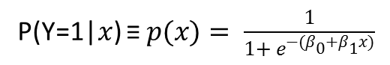
Logistic Response Function
Here is what the logistic model looks like, when there is only 1 predictor, similar to the example we considered for Universal Bank.
So we see that rather than modeling with a linear function, logistic regression model uses an S-shaped non-linear function to model the relationship between the probability and the predictor.
P(Y=1|$x$) ≡ $p(x)= \frac{1}{1+ e^{−(β_{0}+β_{1}x)}}$

Slide 61
Logistic Model for Universal Bank (1 Predictor)
Similar to linear regression, the unknown parameters in the logistic model β0 and β1 need to be estimated from the data. In RStudio, the estimation is carried out using the maximum likelihood method.
Prior to fitting the model, the data were split into 80% training set and 20% testing set, and only the training set was used for fitting the model. Below is the curve of the logistic response function fitted to the training data. One can immediately notice (visually) that it fits better than the simple linear regression model.

Slide 62
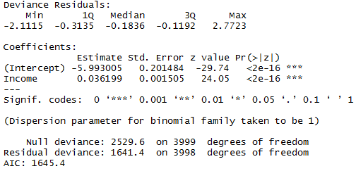
Logistic Model for Universal Bank (1 Predictor)
continued
The summary of the logistic model for Universal Bank example (with 1 predictor), is displayed below. The significant predictors (p-value<0.01) are marked with asterisks.
We see that the parameter corresponding to the Income predictor is significant, and its estimate is 0.036. The fitted model is:
But what is the interpretation of the estimate in logistic regression context? To understand that, we first need to define the important concept of the odds and odds ratios !
β0
β1
P(Y=1|$x$) ≡ $p(x)= \frac{1}{1+ e^{−(−5.993+0.036x)}}$

Slide 63
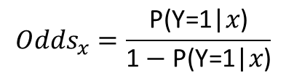
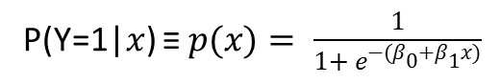
Universal Bank (1 Predictor) – The Odds
To define odds, lets again consider the logistic model in the case when there is only 1 predictor:
Notice, that 1 – P(Y=1|x) is simply the probability that a loan-seeker who has income x fails to accept (i.e. rejects) the loan.
Then, the ratio of the probability of accepting the loan P(Y=1|x) to the probability of rejecting 1 – P(Y=1|x) will show by how much is a loan-seeker with income x more (or less) likely to accept the loan compared to rejecting. That quantity is the odds that a loan-seeker with income x accepts the loan.
P(Y=1|$x$) ≡ $p(x)= \frac{1}{1+ e^{−(β_{0}+β_{1}x)}}$
$${Odds}_{x}=\frac{\text{P}\text{(}\text{Y}\text{=1|}x\text{)}}{\text{1}−\text{P}\text{(}\text{Y}\text{=1|}x\text{)}}$$

Slide 64
The Odds
continued
Odds are popular measures of likelihood in horse races, gambling, … and logistic regression.
Suppose the probability of winning a horse race is 0.5. What are the odds of winning?
What if the probability of winning is 0.8? What does the resulting odds signify that the probability by itself (0.8) does not?

Slide 65
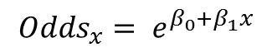
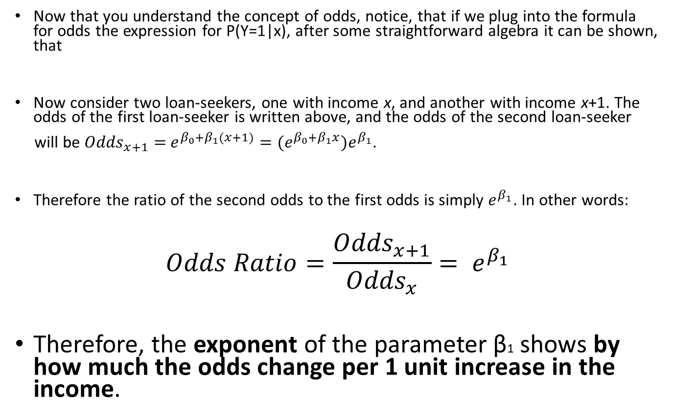
The Odds Ratio
Now that you understand the concept of odds, notice, that if we plug into the formula for odds the expression for P(Y=1|x), after some straightforward algebra it can be shown, that
Now consider two loan-seekers, one with income x, and another with income x+1. The odds of the first loan-seeker is written above, and the odds of the second loan-seeker
will be ${Odds}_{x+1}=$ $e^{β_{0}+β_{1}(x+1)}={(e}^{β_{0}+β_{1}x})e^{β_{1}}$.
Therefore the ratio of the second odds to the first odds is simply $e^{β_{1}}$. In other words:
$$Odds Ratio=\frac{{Odds}_{x+1}}{{Odds}_{x}}= e^{β_{1}}$$
Therefore, the exponent of the parameter β1 shows by how much the odds change per 1 unit increase in the income.
$${Odds}_{x}= e^{β_{0}+β_{1}x}$$

Slide 66
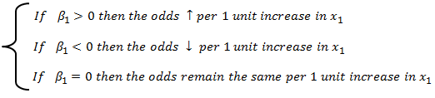
Interpretation of β1
Getting back to the parameter estimation summary for the 1-predictor Universal Bank example, we are now in a position to interpret the parameter estimate for β1 which was 0.036.
Since e^{0.036} is 1.037, that implies that per 1 unit increase in the income (i.e. per $1,000 increase, since income is given in thousands), the odds of accepting the loan changes by a factor of 1.037, in other words the odds go up by 3.7%.
Remember:

Slide 67
Logistic Regression Model as a Classifier
Logistic regression model is often used for classification of observations into classes defined by the levels of the outcome Y.
To understand this, assume, that after having fit the logistic model with 1 predictor to the Universal Bank data a new loan-seeker with an income of 125,000 walks into the bank.
Assume you are considering offering him/her a loan. Think of one way that you can classify him/her as either an acceptor or a rejecter of a loan.
Acceptors
Cutoff
Rejecters
Rejecters
New customer’s income ($125,000)

Slide 68
Logistic Regression Model as a Classifier
So we see that in addition to predicting probabilities, and as a result of that, logistic regression can be used for classification purposes. In our case it can be used to classify loan-seekers into “acceptor” and “rejecter” classes.
The classification rule depends on the selected cutoff. In the example on the previous slide we provisionally chose a cutoff of 0.5 (majority rule).
Although in practice the cutoff is often taken to be 0.5, in some applications it may be different from 0.5 especially if the cost of misclassification varies across the classes.
The following general rule is then used to classify each observation under consideration.
Is the predicted probability of “success” for the observation ≥ Cutoff?
No
Yes
Classify as Failure
Classify as Success

Slide 69
Assessment of Model Performance
As with any other model, there are various ways to assess the adequacy and performance of the logistic regression model.
In this course we be assessing the performance of the logistic model as a classifier, when built on the training set and applied on the testing set.
Two common tools that come handy are the confusion matrix (aka classification matrix) and the Receiver Operating Characteristic (ROC) Curve.
Here is how the classification performance is usually assessed.
Build the classification models using the training set only.
Classify the observations in the testing set using the models built in the previous step.
Evaluate the performance of the models on the testing set by comparing the confusion matrices and/or ROC Curves.

Slide 70
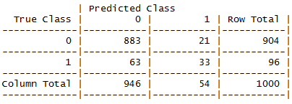
Confusion Matrix (aka Classification Matrix)
The confusion matrix is simply a table, the rows of which denote the true (observed) classes, while the columns stand for classes predicted by the model.
Confusion matrix is a convenient tool to assess the misclassification rate.
The confusion matrix of the logistic regression model based on the testing data for Universal Bank is:
What is the misclassification rate above?
Confusion matrix is used not only for logistic regression but also for other classification methods that we will study throughout the rest of this course.
$$Misclassification Rate= \frac{Number of Misclassified Observations}{Total Number of Observations Being Classified}×100\%$$

Slide 71
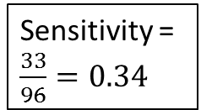
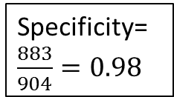
Sensitivity and Specificity
Notice, that the confusion matrix is strictly dependent on the cutoff value chosen for classification. Once you change the cutoff the confusion matrix will change as well!
To define the ROC curve we need to define the concepts of sensitivity and specificity.
Sensitivity is the proportion of true successes (1s) classified correctly as successes.
Specificity is the proportion of true failures (0s) classified correctly as failures.
Notice, that both sensitivity and specificity can easily be found from the confusion matrix!
Sensitivity = $\frac{33}{96}=0.34$
Specificity= $\frac{883}{904}=0.98$

Slide 72
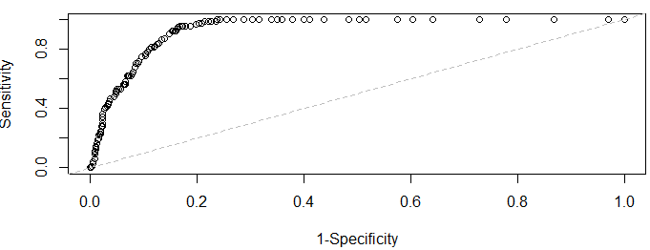
ROC Curve
The ROC curve is simply the plot of sensitivity versus (1 – specificity) for different values of the cutoff.
The ROC curve for the 1-predictor logistic-regression model based on the testing data for Universal Bank is:
When comparing different models, a model resulting in a larger area under the ROC curve is favored over the one that yields a smaller area.

Slide 74
Logistic Regression Models with Many Predictors

Slide 75
Learning Objectives*
Universal Bank Data (In Full)
Logistic Regression Model with Many Predictors
Interpretation of Parameters: Odds and Odds Ratios
Confusion Matrix and ROC Curve
*The material discussed in this lecture assumes no interaction among the predictors entering the logistic model. In the event when there exist interactions, some of the results derived in this lecture may not be valid.

Slide 76
Example: Universal Bank
Universal Bank is a relatively young bank that has already developed itself as a brand name in consumer banking. The bank is trying to expand its customer base, and has recently conducted a comprehensive study to understand what combinations of factors make a loan-seeker more likely to accept a personal loan that the bank offers. The bank’s dataset includes data on 5,000 loan-seekers that were offered the loan. A number of factors (variables) are recorded on each loan-seeker. An extract of the data is provided below.

Slide 77
Example: Universal Bank
continued
The data dictionary is displayed below. We will disregard the “ZIP Code” variable for now.
The outcome here is “Personal Loan” binary variable, that shows whether or not the loan-seeker has accepted the loan offered by the bank (1 for accepted and 0 as rejected). The bank is interested in classifying, based on the list of explanatory variables, whether the loan-seeker will accept the loan or not.

Slide 78
Logistic Regression – q Predictors
In the general case, when we have q predictors corresponding to each observation, what we are basically modeling with logistic regression is the probability of success given the values of the q predictors.
The logistic response function for modeling the probability of “success” , in the case of q predictors is presented below:
$$Probability\left("success" | x_{1},x_{2},…, x_{q}\right)≡p(x_{1},x_{2},…, x_{q})= \frac{1}{1+ e^{−(β_{0}+β_{1}x_{1}+β_{2}x_{2}+ …β_{q}x_{q})}}$$

Slide 79
Universal Bank: Plan of Action
Here is how we will attack this problem:
First we will build a logistic regression model using the training set, which, for each loan-seeker will predict the probability of accepting the loan based on the values of the predictors corresponding to him/her;
We will apply our model to the testing set to predict the probabilities that the loan-seekers will accept the loan in that set;
Then, based on the predicted probabilities we will classify the loan seekers in the testing set the following way:
If the loan-seeker’s probability of accepting the loan is greater than or equal to 0.5 then we will classify him/her as an “acceptor” (i.e. – will assign the number “1” which is the number corresponding to the “success”);
Otherwise (probability of accepting <0.5) we will classify him/her as a “rejecter” (i.e. – will assign the number “0” which is the number corresponding to the “failure”).
Finally, we will assess the performance of our model (classification method) judging by its accuracy in classifying the loan-seekers in the testing set.

Slide 80
Example: Universal Bank
continued
First things first, let’s denote by Y the “Personal Loan” binary variable that we will be using for modeling.
Recall from last lecture, that since we are trying to model/predict the probability of accepting the loan, then the loan acceptance (Y=1) is the event the probability of which we will model, and thus acceptance of the loan in this context is what we consider as the “success” event.
But what exactly are we modeling here? What we are modeling is the probability that a loan-seeker with a given characteristics (age, income, education, etc.) will accept a loan that Universal bank offers.
Thus, what we will do next, is to fit the model using RStudio and focus on the interpretation of the model parameters. Then we will proceed to prediction and model assessment.

Slide 81
Example: Universal Bank – Preprocessing
The data file “Universal Bank”.
We will make all the required data preparations and pre-processing prior to fitting the model. In particular we:
Will re-define the data set and the outcome variable to “mydata” and “myresponse” respectively;
Will transform all the categorical variables that are read into R as integer or numeric to factor level;
Will eliminate from the dataset all the redundant variables that will not enter the model;
Will break down the entire data (5,000) into training (80%) and testing (20%) sets.

Slide 82
LOGISTIC MACRO
The program “LOGISTIC MACRO” contains all the necessary RStudio code that you will need for logistic modeling in this course. All you have to do is to learn how to modify the code before running.
Notice, that once you successfully modify the code of LOGISTIC MACRO, it will automatically produce:
The summary of the logistic regression model that you specify in the code to be fit to training data;
The confusion matrix and the ROC curve based on predicting the testing set with the model built on the training set.
Remember, that when fitting several different models to the data, you need to fit them one-by-one, appropriately updating the code for each of your models.

Slide 83
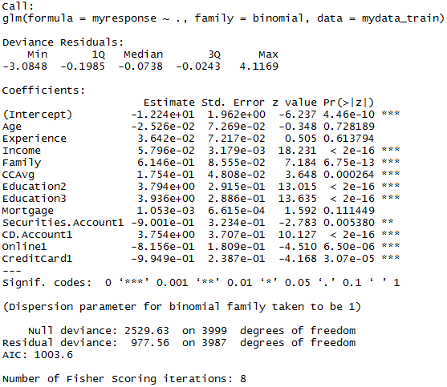
Example: Universal Bank – Fitting
We fit the logistic model to the training data. The estimation results are displayed below. The significant predictors (p-value<0.01) are marked with asterisks.

Slide 84
Example: Universal Bank – The Interpretation (Quantitative)
The interpretation of the estimates corresponding to numerical predictors (discrete or continuous) is the same as the interpretation that we discussed for 1 predictor.
For example, we see that the parameter estimate corresponding to average monthly credit card spending (CCAvg) is statistically significant and equals 0.175. That means, that when holding all the predictors other than CCAvg constant, per 1 unit increase in CCAvg the odds that a borrower accepts the loan (i.e. – “success”) change by a factor of e^{0.175} = 1.19.
Another way to put this is that, everything else the same, when average monthly credit card spending goes up by $1,000 the odds of accepting the loan go up by 19%.

Slide 85
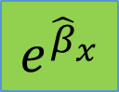
Example: Universal Bank – The Interpretation (Quantitative)
continued
The following flowchart describes the interpretation of the estimates corresponding to quantitative predictors. If we denote the parameter estimate corresponding to predictor x by $\hat{β}$x, then, when holding all other predictor values the same, per 1 unit increase in the value of predictor x:
Odds of “success” at x+1
Odds of “success” at x
=
×
$$e^{{\hat{β}}_{x}}$$

Slide 86
Example: Universal Bank – The Interpretation (Categorical)
continued
The interpretation of the parameter estimates corresponding to categorical predictors is a little different, however.
Notice, that for a categorical variable (factor) with K levels there are K-1 corresponding coefficients in the fit summary in RStudio. The level that is NOT parameterized in the summary below is called the reference level.
For instance, since
Education has 3 levels (1, 2,
and 3), there are 2 parameters,
corresponding to level 2
and level 3.
Level 1 is thus the reference.
Similarly, since CreditCard
has 2 levels (0 and 1) there
is 1 parameter corresponding
to level 1. Level 0 here is the reference.

Slide 87
Example: Universal Bank – The Interpretation (Categorical)
continued
The interpretation of the parameters for categorical variables is as follows:
The exponent of the parameter estimate corresponding to level u shows by how much do the odds of “success” change (go up or down) when the categorical variable changes from its reference level to level u.
For example, the parameter estimate of CreditCard1 is -0.949, which has the following interpretation:
Compared to those loan-seekers who do not hold a credit card (i.e. – the reference level 0), the odds of those loan-seekers who hold a credit card (i.e. level 1) is different by a factor of e^{-0.949} = 0.38 when it comes to accepting the loan. In other words, the odds that a holder of a credit card will accept the offered loan is roughly by 62% less than the odds of that a non-holder accepts it!

Slide 88

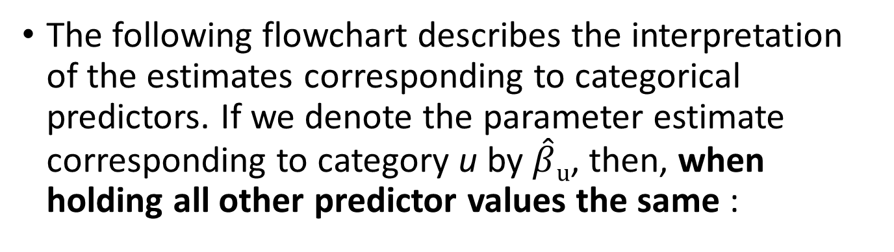
Example: Universal Bank – The Interpretation (Categorical)
continued
The following flowchart describes the interpretation of the estimates corresponding to categorical predictors. If we denote the parameter estimate corresponding to category u by $\hat{β}u$, then, when holding all other predictor values the same :
Odds of “success” at level u
Odds of “success” at the reference level
=
×
$$e^{{\hat{β}}_{u}}$$

Slide 89
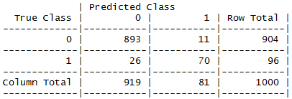
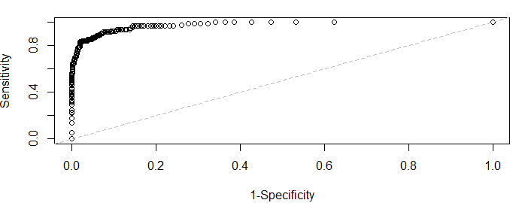
Assessing the Model Performance
Below are the confusion matrix and the ROC curve for our model. Note, that both are based on using the model built on the training set and applied to predict the testing set.
Sensitivity =
Specificity=

Slide 90
Advantages and Limitations of Logistic Regression
Advantages
Provides a rich insight regarding the relationships among the predictors and the outcome through odds ratio interpretation of the model parameters;
Is not as computationally intensive to estimate as compared to methods such as KNN;
Provides confidence intervals for the parameter estimates and estimated probabilities, as well as prediction intervals for predicting success probabilities of new observations.
Limitations
The model assumes that the logarithm of the odds is a linear function of the predictors. In other words, that 1 unit increase in the value of a given predictor, everything else kept constant, has the same influence on the logarithm of odds regardless of the actual value of the predictor.
The standard errors of the parameters estimates and thus the p-values suffer when the predictors are correlated among each other (multicollinearity).
Assumes that the (categorical-valued) observations are independent.

Slide 91
Which Classifier Should I Try?
Typical Questions | Recommended Method
Do I want class probabilities, rather than just class labels? | Logistic regression Decision Tree
Do I want insight into how the variables affect the model? | Logistic regression Decision Tree
Is the problem high-dimensional? | Naïve Bayes
Do I suspect some of the inputs are correlated? | Decision Tree Logistic Regression
Do I suspect some of the inputs are irrelevant? | Decision Tree Naïve Bayes
Are there categorical variables with a large number of levels? | Naïve Bayes Decision Tree
Are there mixed variable types? | Decision Tree Logistic Regression
Is there non-linear data or discontinuities in the inputs that will affect the outputs? | Decision Tree
Source: EMC

